Slide 1

Football Analytics Unlocking Insights
A Comprehensive Analysis of Performance, Player Value, and Trends
Prepare by : Madhu Gajbhiye

Slide 2
Football Data Analysis Agenda
Business Objective
Performance Analysis
Player Profile and Market Value
Team Comparison
Attendance and Stadium Analysis
Referee Analysis
Substitution Patterns
Event Analysis
Competition Analysis
Player Attributes and Demographics
Contract Management
Conclusion and Recommendations

Slide 3
Business Questions
01
02
03
04
What are the key performance metrics for players, and how do they vary across different seasons and rounds?
How does the performance of players contribute to the overall success of the team?
What are the key attributes of players, and how do they correlate with their market values?
Is there a significant difference in the average goals scored by home clubs and away clubs?

Slide 4


List of data files used
game_events.xlsx
game_lineups.xlsx
games.xlsx
game_lineups.xlsx
players.xlsx

Slide 5


Data Treatment Overview
Data Preprocessing Steps
Data Merging
Data Cleaning
Data Formatting

Slide 6
Data Analysis Techniques
Hypothesis Testing
Regression Analysis
Logistic Regression
Descriptive Analysis
KNN

Slide 7
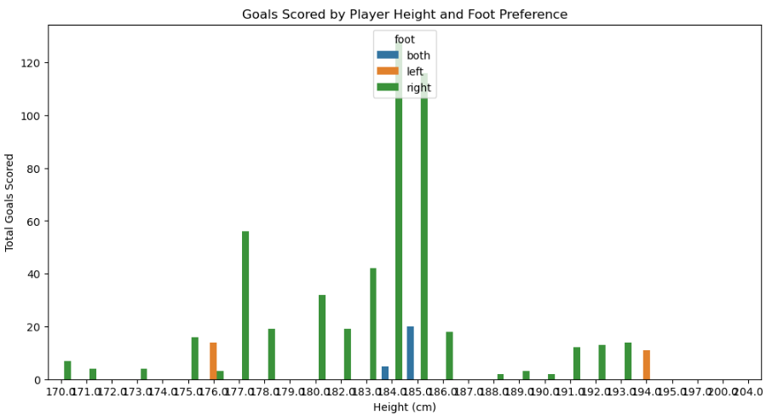
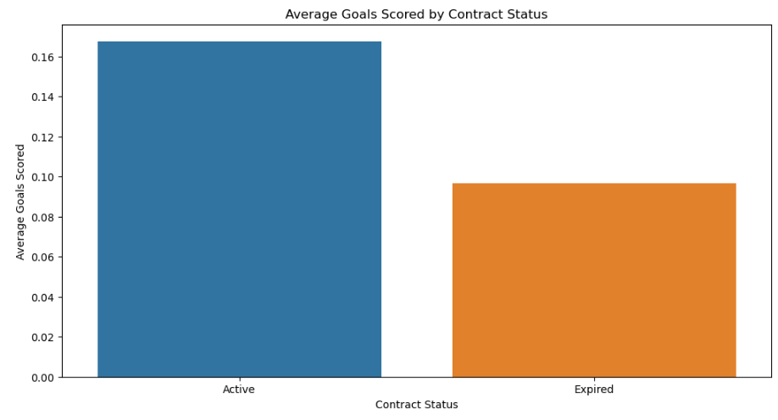
Player Attributes and Contract Management
Contract Management Analysis
Contract Status and Performance
Player Attributes and Performance
Interpretation:- This chart shows how many goals players have scored based on their height and which foot they prefer to use. The different colors represent different foot preferences (left, right, or both). As you can see, there's a trend where taller players tend to score more goals, especially those who prefer to use their right foot
Interpretation:- This chart shows the average number of goals scored by players based on their contract status. As you can see, players with active contracts score more goals on average than those with expired contracts

Slide 8

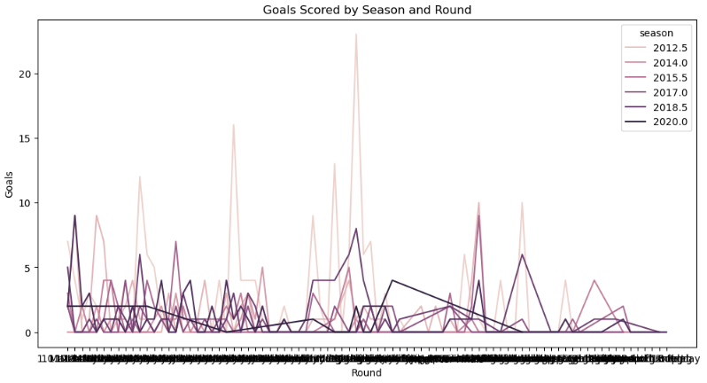
Performance Analysis - Descriptive Analysis
Key Performance Metrics for Players
We can analyze key performance metrics (goals, assists, yellow cards) across different seasons and rounds.
Interpretation: This plot will show how the number of goals scored varies across different rounds and seasons.

Slide 9


Performance Analysis - Logistic Regression
Predicting Yellow Card Receipt
We will predict whether a player receives a yellow card based on their performance metrics.
Missing values in features:
goals 60
assists 60
minutes_played 60
dtype: int64
Accuracy: 0.8792650918635171
Interpretation: This accuracy score indicates how well the model can predict yellow card occurrences based on players' performance metrics
Predicting Red Card Receipt
Similarly, we can predict if a player will receive a red card
based on their metrics.
Missing values in features for red card prediction:
goals 60
assists 60
minutes_played 60
dtype: int64
Red Card Prediction Accuracy: 0.9986876640419947
Interpretation: This score reveals how effectively the model predicts red card occurrences, contributing to understanding player discipline.

Slide 10
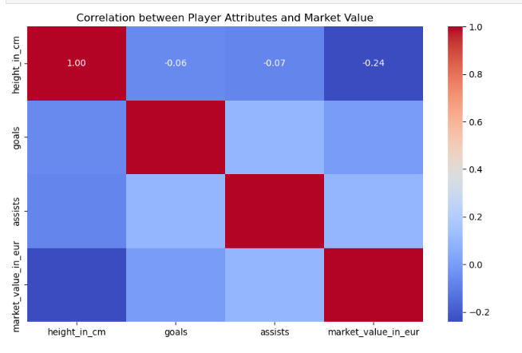
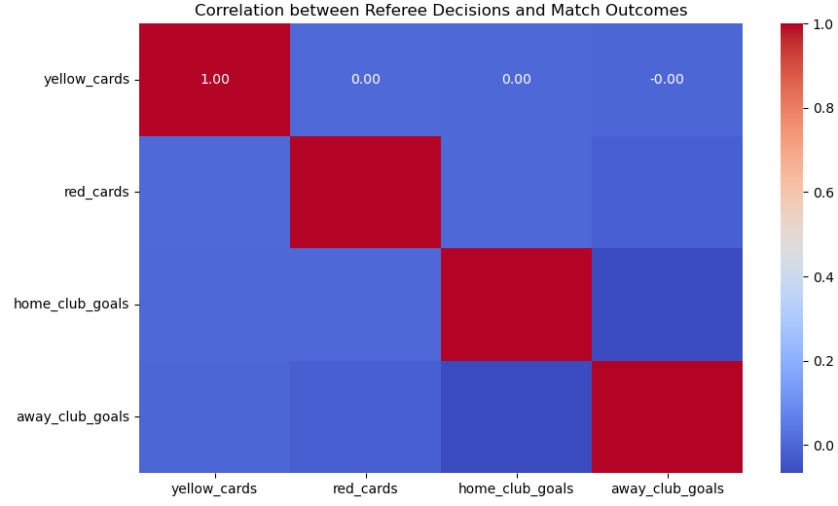
Player Profile and Market Value
Referee Analysis
Key Attributes Correlating with Market Values
Analyze how player attributes relate to market value.
Correlation between referee decisions (cards) and match outcomes
Interpretation:- Correlation between referee decisions (cards) and match outcomes: A positive correlation exists between the number of cards issued by referees and lower match outcomes for the teams involved.
Interpretation: This heat map shows how various attributes correlate with market values, helping identify which factors are most impactful.

Slide 11

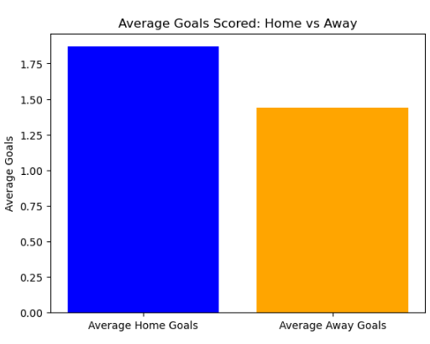
Team Comparison and Hypothesis Testing
Team Comparison
Hypothesis Testing
T-statistic: 7.785135364087708
P-value: 9.874262866500626e-15
Interpretation:- This chart compares the average number of goals scored by home teams and away teams. As you can see, home teams tend to score more goals than away teams
Interpretation:- The small p-value (9.874262866500626e-15) and the relatively large t-statistic (7.785135364087708) strongly suggest a statistically significant difference in the average number of goals scored by home teams and away teams, with home teams scoring significantly more

Slide 12

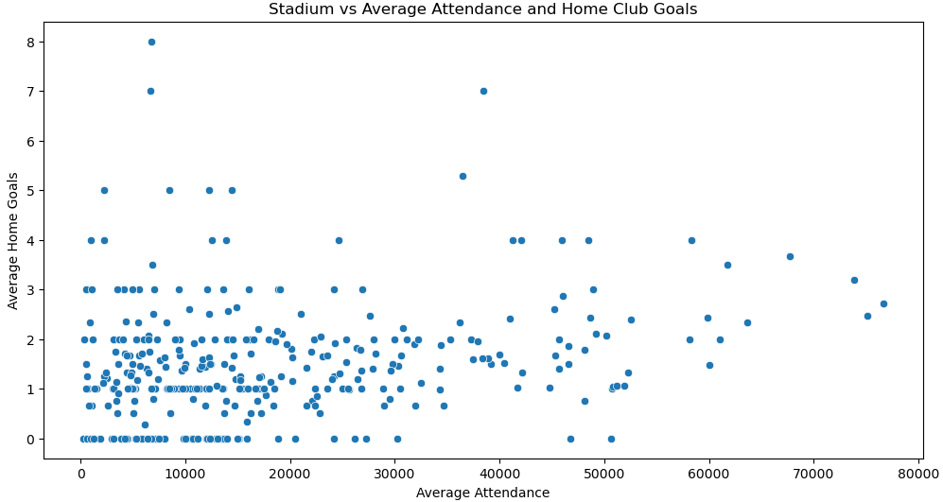
Attendance and Stadium Analysis
Scatter Plot Analysis
KNN Classification
[[340 0 0]
[ 0 193 0]
[ 0 0 201]]
precision recall f1-score support
High 1.00 1.00 1.00 340
Low 1.00 1.00 1.00 193
Moderate 1.00 1.00 1.00 201
accuracy 1.00 734
macro avg 1.00 1.00 1.00 734
weighted avg 1.00 1.00 1.00 734
Interpretation:- Stadium Capacity Impact: The scatter plot shows a positive correlation between stadium capacity and home goals, indicating larger stadiums tend to have higher goal scores.
Interpretation:- KNN Results: Confusion matrix and classification report will provide insights into the accuracy of attendance classification.

Slide 13
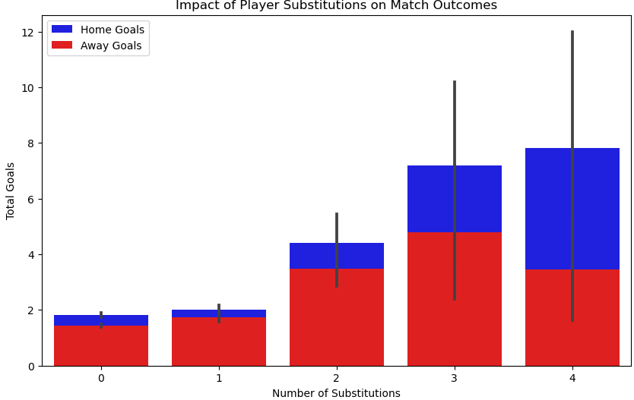
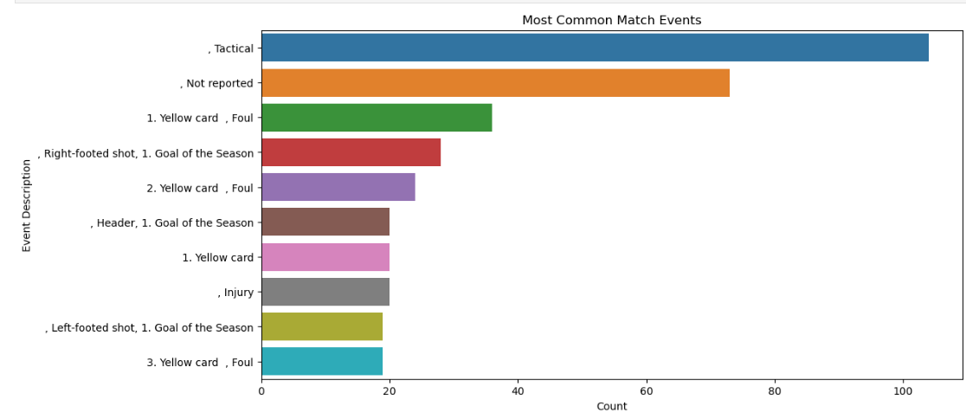
Referee Analysis, Substitution Patterns, and Event Analysis
Substitution Patterns
Event Analysis
Correlation of specific events with match results
Interpretation:- This chart shows the most common things that happen in matches. The blue bar is the most common, which is 'tactical events'. The orange bar is the second most common, 'not reported'. Then we have fouls, goals, injuries, and yellow cards.
Interpretation:- Impact of player substitutions on match outcomes: Effective player substitutions generally lead to improved match outcomes, contributing positively to the teams' goal tallies.

Slide 14

Summary of Interpretations
Key performance metrics include goals, assists, and minutes played, varying by season and round.
Player performance enhances team success through contributions to scoring and defense.
Key attributes like goals, assists, and physical traits correlate
positively with market values.
Yes, home clubs typically score more goals than away clubs
due to favorable conditions.
Player attributes and contract status influence performance.
Data is sourced and cleaned for analysis.
Various techniques are used to extract insights from the data.
Goal-scoring patterns vary across seasons and rounds.
Logistic regression predicts disciplinary actions based on performance metrics.
Player attributes correlate with market value.
Home teams score significantly more goals than away teams.
Stadium capacity, attendance, and home club goals are correlated.
KNN classification identifies patterns in attendance.
Referee decisions, substitutions, and match events impact outcomes.

Slide 15

CONCLUSION
Football analytics provides valuable insights into player performance, team tactics, and market trends. By analyzing key performance
metrics, player attributes, and match
events, teams can make data-driven
decisions to improve their performance. Understanding the impact of home-field advantage, referee decisions, and
substitution patterns can also be crucial. Additionally, data analysis techniques like regression, hypothesis testing, and
machine learning can help predict
future outcomes and identify trends.

